Slide 1

Some questions over previous classes
What is Algorithm? Mention its Characteristics.
Discuss Time and Space Complexity of an algorithm?
What do you mean by Machine independent time complexity?
What is RAM model?
Write the pseudo-code of Insertion sort and find worst, best, and average case time complexities of insertion sort.
Find the time complexities of Bubble sort and selection sort.
What do you mean by Asymptotic notation?
Explain with example: O-notation, Ω-notation, -notation.

Slide 2
Recurrence Relation

Slide 3
Analysis of Recursive Algorithms
What is a recurrence relation?
Forming Recurrence Relations
Solving Recurrence Relations
Analysis Of Recursive Factorial method
Analysis Of Recursive Selection Sort
Analysis Of Recursive Binary Search
Analysis Of Recursive Towers of Hanoi Algorithm

Slide 4
Recursion
Recursion can solve many programming problems that are difficult to conceptualize and solve linearly
In the field of artificial intelligence, recursion often is used to write programs that exhibit intelligent behavior:
  playing games of chess
  proving mathematical theorems
  recognizing patterns, and so on
Recursive algorithms can
  compute factorials
  compute a greatest common divisor
  process data structures (strings, arrays, linked lists, etc.)
  search efficiently using a binary search
  find a path through a maze, and more

Slide 5
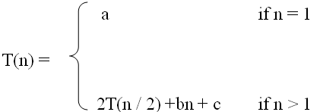
What is a recurrence relation?
A recurrence relation, T(n), is a recursive function of integer variable n.
Like all recursive functions, it has both recursive case and base case.
Example:
The portion of the definition that does not contain T is called the base case of the recurrence relation; the portion that contains T is called the recurrent or recursive case.
Recurrence relations are useful for expressing the running times (i.e., the number of basic operations executed) of recursive algorithms

Slide 6

Forming Recurrence Relations
For a given recursive method, the base case and the recursive case of its recurrence relation correspond directly to the base case and the recursive case of the method.
Example 1: Write the recurrence relation for the following method.
The base case is reached when n == 0. The method performs one comparison. Thus, the number of operations when n == 0, T(0), is some constant a.
When n > 0, the method performs two basic operations and then calls itself, using ONE recursive call, with a parameter n – 1.
Therefore the recurrence relation is:
int f (int n) {
if (n > 0) {
printf(n);
f(n-1);
}
}

Slide 7

Forming Recurrence Relations
Example 2: Write the recurrence relation for the following method.
The base case is reached when n == 1. The method performs one comparison and one return statement. Therefore, T(1), is constant c.
When n > 1, the method performs TWO recursive calls, each with the parameter n / 2, and some constant # of basic operations.
Hence, the recurrence relation is:
int g(int n) {
if (n == 1)
return 2;
else
return 3 * g(n / 2) + g( n / 2) + 5;
}

Slide 8
Solving Recurrence Relations
To solve a recurrence relation T(n) we need to derive a form of T(n) that is not a recurrence relation. Such a form is called a closed form of the recurrence relation.
There are four methods to solve recurrence relations that represent the running time of recursive methods:
  Iteration method (unrolling and summing)
  Substitution method (Intelligent Guess Work)
  Recursion tree method
  Master method

Slide 9

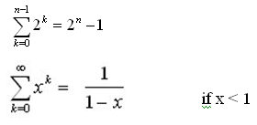


Solving Recurrence Relations - Iteration method
Steps:
  Expand the recurrence
  Express the expansion as a summation by plugging the recurrence back into itself until you see a pattern.
  Evaluate the summation
In evaluating the summation one or more of the following summation formulae may be used:
Arithmetic series:
Geometric Series:
Special Cases of Geometric Series:

Slide 10

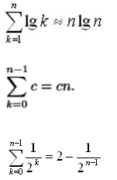
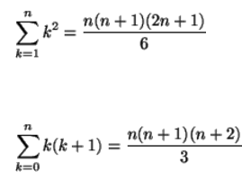
Solving Recurrence Relations - Iteration method
Harmonic Series:
Others:

Slide 11
Eg. 1 - Linear Search
Recursively
Look at an element (constant work, c), then search the remaining elements…
T(n) = T( n-1 ) + c
“The cost of searching n elements is the cost of looking at 1 element, plus the cost of searching n-1 elements”

Slide 12
  Iteration method (unrolling and summing)

Slide 13
Linear Seach (cont)
Requirement:
You need to convince yourself (and others) that the single step, examining an element, *is* done in constant time.
Can I get to the i^{th} element in constant time, either directly, or from the (i-1)^{th} element?
Look at the code

Slide 14
Linear Search (cont.)
We’ll “unwind” a few of these
T(n) = T(n-1) + c (1)
  But, T(n-1) = T(n-2) + c, from above
Substituting back in:
T(n) = T(n-2) + c + c
Gathering like terms
T(n) = T(n-2) + 2c (2)

Slide 15
Linear Search (cont.)
Keep going:
  T(n) = T(n-2) + 2c
    T(n-2) = T(n-3) + c
  T(n) = T(n-3) + c + 2c
  T(n) = T(n-3) + 3c (3)
One more:
  T(n) = T(n-4) + 4c (4)

Slide 16
Eg. 1 – list of intermediates
Result at i^{th} unwinding | i
T(n) = T(n-1) + 1c | 1
T(n) = T(n-2) + 2c | 2
T(n) = T(n-3) + 3c | 3
T(n) = T(n-4) + 4c | 4
Kurt Schmidt
Drexel University

Slide 17
Linear Search (cont.)
An expression for the kth unwinding:
  T(n) = T(n-k) + kc
We have 2 variables, k and n, but we have a relation
T(d) is constant (can be determined) for some constant d (we know the algorithm)
Choose any convenient # to stop.

Slide 18
Linear Search (cont.)
Let’s decide to stop at T(0). When the list to search is empty, you’re done…
0 is convenient, in this example…
  Let n-k = 0 => n=k
Now, substitute n in everywhere for k:
  T(n) = T(n-n) + nc
  T(n) = T(0) + nc = nc + c₀ = O(n)
    ( T(0) is some constant, c₀ )

Slide 19
Solving Recurrence Relations - Iteration method
Steps:
  Expand the recurrence
  Express the expansion as a summation by plugging the recurrence back into itself until you see a pattern.
  Evaluate the summation
In evaluating the summation one or more of the following summation formulae may be used:
Arithmetic series:
Geometric Series:
Special Cases of Geometric Series:

Slide 20
Solving Recurrence Relations - Iteration method
Harmonic Series:
Others:

Slide 21
Analysis Of Recursive Factorial method
Example1: Form and solve the recurrence relation for the running time of factorial method and hence determine its big-O complexity:
  T(0) = c
  T(n) = b + T(n - 1)
  = b + b + T(n - 2)
  = b +b +b + T(n - 3)
  …
  = kb + T(n - k)
  When k = n, we have:
  T(n) = nb + T(n - n)
  = bn + T(0)
  = bn + c.
  Therefore method factorial is O(n).
int factorial (int n) {
if (n == 0)
return 1;
else
return n * factorial (n – 1);
}

Slide 22
Analysis Of Recursive Binary Search
The recurrence relation for the running time of the method is:
  T(1) = a if n = 1 (one element array)
  T(n) = T(n / 2) + b if n > 1
int binarySearch (int target, int[] array,int low, int high)
{
if (low > high)
return -1;
else {
int middle = (low + high)/2;
if (array[middle] == target)
return middle;
else if(array[middle] < target)
return binarySearch(target, array, middle + 1, high);
else
return binarySearch(target, array, low, middle - 1);
}
}

Slide 23
Analysis Of Recursive Binary Search
  Expanding:
  T(n) = T(n / 2) + b
  = [T(n / 4) + b] + b = T (n / 2²) + 2b
  = [T(n / 8) + b] + 2b = T(n / 2³) + 3b
  = ……..
  = T( n / 2^{k}) + kb
  When n / 2^{k} = 1 ➔ n = 2^{k} ➔ k = log₂ n, we have:
  T(n) = T(1) + b log₂ n
  = a + b log₂ n
  Therefore, Recursive Binary Search is O(log n)

Slide 24
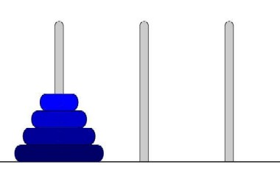
Tower of Hanoi
Tower of Hanoi is a mathematical puzzle invented by a French Mathematician Edouard Lucas in 1883.
The game starts by having few discs stacked in increasing order of size. The number of discs can vary, but there are only three pegs.

Slide 25
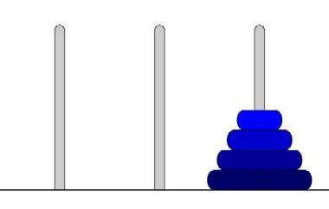
Tower of Hanoi
The Objective is to transfer the entire tower to one of the other pegs. However you can only move one disk at a time and you can never stack a larger disk onto a smaller disk. Try to solve it in fewest possible moves.

Slide 26
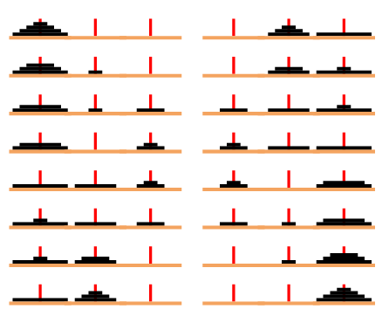
Tower of Hanoi

Slide 27
Tower of Hanoi
Solution
To get a better understanding for the general algorithm used to solve
the Tower of Hanoi, try to solve the puzzle with a small amount of
Disks, 3 or 4, and once you master that , you can solve the same
puzzle with more discs with the following algorithm.

Slide 28
Tower of Hanoi
Recursive Solution for the Tower of Hanoi with algorithm
public static void hanoi(int n, char BEG, char AUX, char END)
{
if (n == 1)
System.out.println(BEG + " --------> " + END);
else
{
hanoi(n - 1, BEG, END, AUX);
System.out.println(BEG + " --------> " + END);
hanoi(n - 1, AUX, BEG,END);
}
}

Slide 29
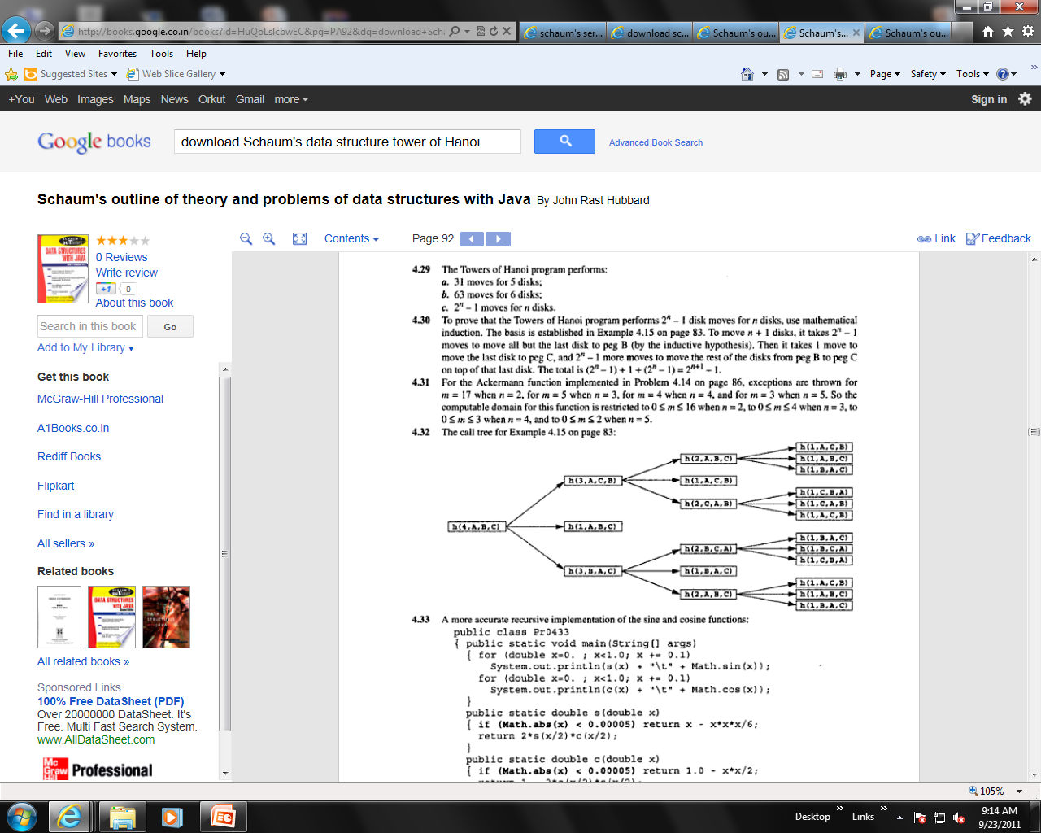

Slide 30
Tower of Hanoi
How many moves will it take to transfer n disks from the left post to the right post?
The recursive pattern can help us generate more numbers to find an explicit (non-recursive) pattern. Here's how to find the number of moves needed to transfer larger numbers of disks from post A to post C, remembering that M = the number of moves needed to transfer n-1 disks from post A to post C:
for 1 disk it takes 1 move to transfer 1 disk from post A to post C;
for 2 disks, it will take 3 moves: 2M + 1 = 2(1) + 1 = 3
for 3 disks, it will take 7 moves: 2M + 1 = 2(3) + 1 = 7
for 4 disks, it will take 15 moves: 2M + 1 = 2(7) + 1 = 15
for 5 disks, it will take 31 moves: 2M + 1 = 2(15) + 1 = 31
for 6 disks... ?

Slide 31
Tower of Hanoi
Explicit Pattern
Number of Disks Number of Moves
1 1
2 3
3 7
4 15
5 31
Powers of two help reveal the pattern:
Number of Disks (n) Number of Moves
1 2^1 - 1 = 2 - 1 = 1
2 2^2 - 1 = 4 - 1 = 3
3 2^3 - 1 = 8 - 1 = 7
4 2^4 - 1 = 16 - 1 = 15
5 2^5 - 1 = 32 - 1 = 31

Slide 32
Analysis Of Recursive Towers of Hanoi Algorithm
The recurrence relation for the running time of the method hanoi is:
  T(n) = a if n = 1
  T(n) = 2T(n - 1) + b if n > 1
hanoi(int n, char BEG, char AUX, char END){
if (n == 1)
System.out.println(from + " --------> " + to);
else{
hanoi(n - 1, BEG, END, AUX);
System.out.println(from + " --------> " + to);
hanoi(n - 1, END, AUX, BEG);
}
}

Slide 33
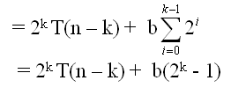
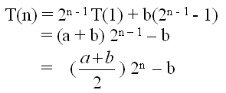
Analysis Of Recursive Towers of Hanoi Algorithm
Expanding:
T(n) = 2T(n – 1) + b
= 2[2T(n – 2) + b] + b = 2² T(n – 2) + 2b + b
= 2² [2T(n – 3) + b] + 2b + b = 2³ T(n – 3) + 2²b + 2b + b
= 2³ [2T(n – 4) + b] + 2²b + 2b + b = 2⁴ T(n – 4) + 2³ b + 2²b + 2¹b + 2⁰b
= ……
= 2^{k} T(n – k) + b[2^{k- 1} + 2^{k– 2} + . . . 2¹ + 2⁰]
When k = n – 1, we have:
Therefore, The method hanoi is O(2^{n})

Slide 34
Some Problem
T(n) = T(n-1) + logn ; T(0) = 1
T(n) = 2T(n-1) + 1 ; T(0) = 1

Slide 35
Some Questions
What is Algorithm? Mention its Characteristics.
Discuss Time and Space Complexity of an algorithm?
What do you mean by Machine independent time complexity?
What is RAM model?
Write the pseudocode of Insertion sort and find worst, best, and average case time complexities of insertion sort.
Find the time complexities of Bubble sort and selection sort.
What do you mean by Asymptotic notation?
Explain with example: O-notation, Ω-notation, -notation.

Slide 36
Recursion-tree method
A recursion tree models the costs (time) of a recursive execution of an algorithm.
The recursion-tree method can be unreliable, just like any method that uses ellipses (…).
The recursion-tree method promotes intuition, however.
The recursion tree method is good for generating guesses for the substitution method.

Slide 37
Recursion tree
Solve T(n) = 2T(n/2) + cn, where c > 0 is constant.
L1.<number>

Slide 38
Recursion tree
Solve T(n) = 2T(n/2) + cn, where c > 0 is constant.
T(n)
L1.<number>

Slide 39
Recursion tree
Solve T(n) = 2T(n/2) + cn, where c > 0 is constant.
cn
T(n/2)
T(n/2)
L1.<number>

Slide 40
Recursion tree
Solve T(n) = 2T(n/2) + cn, where c > 0 is constant.
cn
cn/2
cn/2
T(n/4)
T(n/4)
T(n/4)
T(n/4)
L1.<number>

Slide 41
Recursion tree
Solve T(n) = 2T(n/2) + cn, where c > 0 is constant.
cn
cn/2
cn/2
cn/4
cn/4
cn/4
cn/4
…
Θ(1)
L1.<number>

Slide 42
Recursion tree
Solve T(n) = 2T(n/2) + cn, where c > 0 is constant.
cn
cn/2
cn/2
h = lg n
cn/4
cn/4
cn/4
cn/4
…
Θ(1)
L1.<number>

Slide 43
Recursion tree
Solve T(n) = 2T(n/2) + cn, where c > 0 is constant.
cn
cn
cn/2
cn/2
h = lg n
cn/4
cn/4
cn/4
cn/4
…
Θ(1)
L1.<number>

Slide 44
Recursion tree
Solve T(n) = 2T(n/2) + cn, where c > 0 is constant.
cn
cn
cn/2
cn/2
cn
h = lg n
cn/4
cn/4
cn/4
cn/4
…
Θ(1)
L1.<number>

Slide 45
Recursion tree
Solve T(n) = 2T(n/2) + cn, where c > 0 is constant.
cn
cn
cn/2
cn/2
cn
h = lg n
cn/4
cn/4
cn/4
cn/4
cn
…
…
Θ(1)
L1.<number>

Slide 46
Recursion tree
Solve T(n) = 2T(n/2) + cn, where c > 0 is constant.
cn
cn
cn/2
cn/2
cn
h = lg n
cn/4
cn/4
cn/4
cn/4
cn
…
…
Θ(1)
#leaves = n
Θ(n)
L1.<number>

Slide 47
Recursion tree
Solve T(n) = 2T(n/2) + cn, where c > 0 is constant.
cn
cn
cn/2
cn/2
cn
h = lg n
cn/4
cn/4
cn/4
cn/4
cn
…
…
Θ(1)
#leaves = n
Θ(n)
Total = Θ(n lg n)
L1.<number>

Slide 48
Conclusions
Θ(n lg n) grows more slowly than Θ(n²).
Therefore, merge sort asymptotically beats insertion sort in the worst case.
In practice, merge sort beats insertion sort for n > 30 or so.
L1.<number>

Slide 49
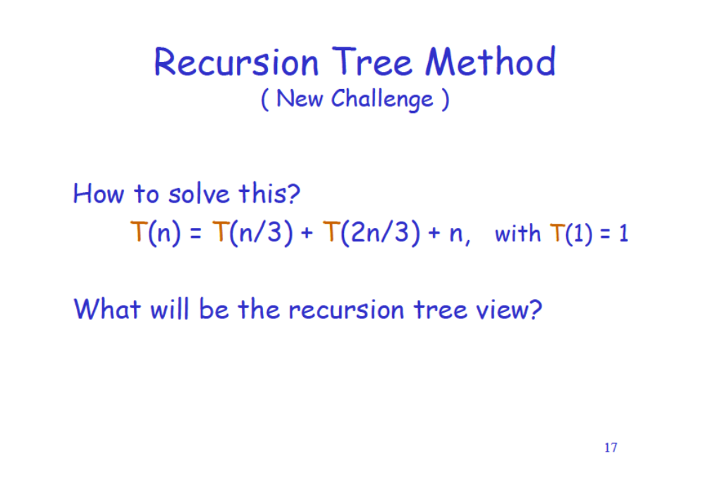


Assignment 1a

Slide 50
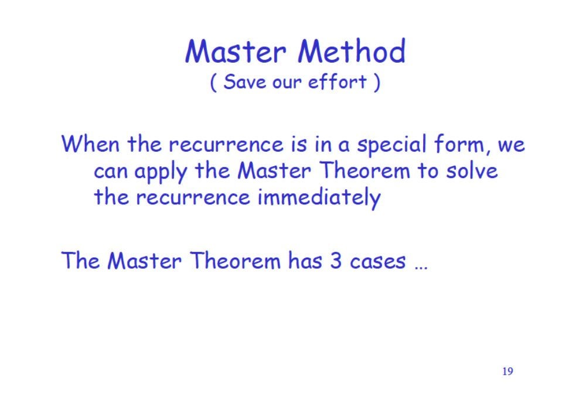

Slide 51
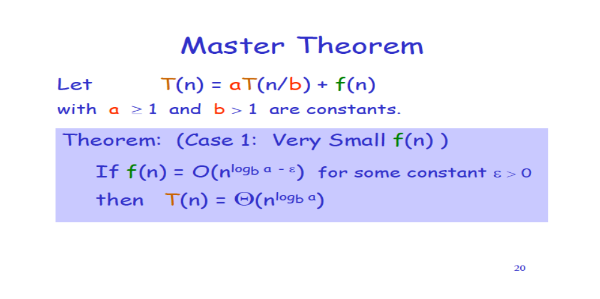
Master Theorem
Mater Theorem : a COOK BOOK
Need to remember three cases

Slide 52
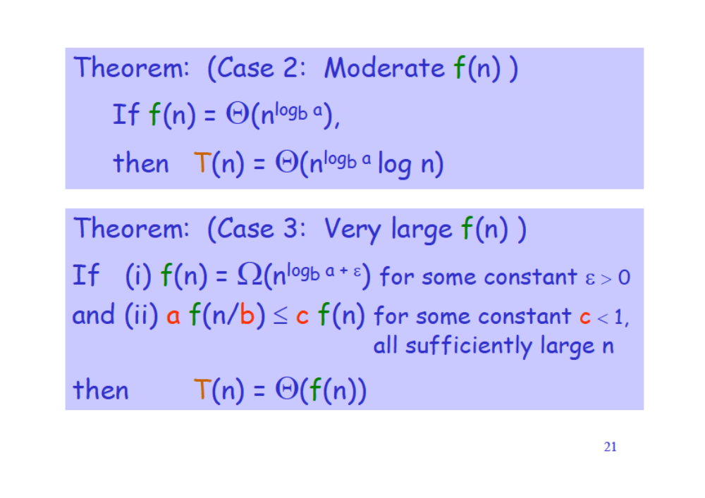

Slide 53
Asssignment 1b
Explain Master theorm and find out solution for given below
Solve T (T (n) = 7T (n/2) + n
Solve T (n) = 7T (n/2) + n²
Solve T (n) = T (9n/10) + n
DeadLine : 2 Weeks

